Slide 1

Notes:
Cover Slide

Slide 2


PRESENTATION SKILLS-STRATEGIC SKILLS

Slide 3


PRESENTATION SKILLS
INTRODUCTION
What is a strategic presentation?
Notes:
As professionals, we present ourselves in a variety of ways, including the manner in which we collaborate, write, design visuals, and speak. Each of these influences how we are viewed, how others position us in an organisation and, in some cases, the pace at which we accelerate towards our career goals. The purpose of Strategic Presentation Skills is to use and further develop these skills to be able to produce and deliver focused, creative, evidence-driven approaches to the way we present ourselves verbally.

Slide 4

PRESENTATION SKILLS
CONCEPTS
Visual Aid Definition

Slide 5
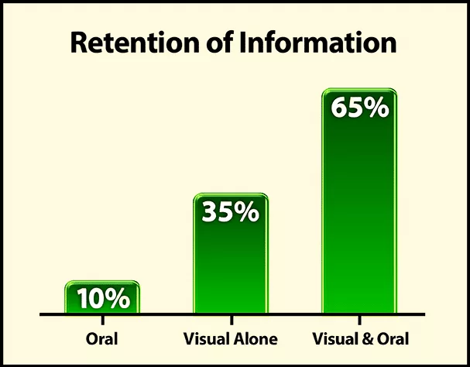
PRESENTATION SKILLS
CONCEPTS
Why use visuals for presentations?
Notes:
There is no such thing as a perfect speech. However, there are ways to make a presentation that is closer to perfection. What are they? Simple: Visual aids. Visual aids can bring life back into a tedious speech, and they take less time to come up with than long notes. In this article, we discuss how you can use visual aids effectively and conquer an audience. Before that, we discuss how visuals can help you achieve a better presentation.

Slide 6
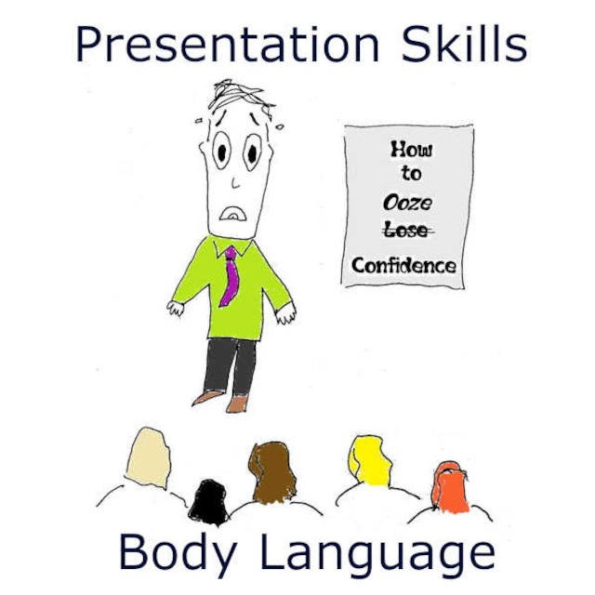
PRESENTATION SKILLS
CONCEPTS
They help you structure your work
Notes:
Using the right types of visual aids can help you create a perfect picture of what you want your audience to see in your presentations. Instead of struggling to condense a lot of information into a long text, you can present your information in one straightforward image or video and save yourself the stress.

Slide 7

PRESENTATION SKILLS
CONCEPTS
It is easier to engage the audience
Notes:
An excellent visual setup can help you elicit audience interest and sometimes their input in the presentation. When the audience is engaged, they tend to be more interested in the presenter’s work. Also, an interactive audience can boost your morale and give you some encouragement.

Slide 8

PRESENTATION SKILLS
CONCEPTS
You save time on your presentation
Notes:
When presenting, time is of the essence. So, you can effectively reduce your presentation time if you have useful visual aids, and use them properly. Would you prefer to go on and on for minutes about a topic when you can cut your speech down by inserting a few images or videos?

Slide 9

PRESENTATION SKILLS
CONCEPTS
What are visual aids?
Notes:
A visual aid is any material that gives shape and form to words or thoughts. Types of visual aids include physical samples, models, handouts, pictures, videos, infographics, etc. Visual aids have come a long way to now include digital tools such as overhead projectors, PowerPoint presentations, and interactive boards.

Slide 10
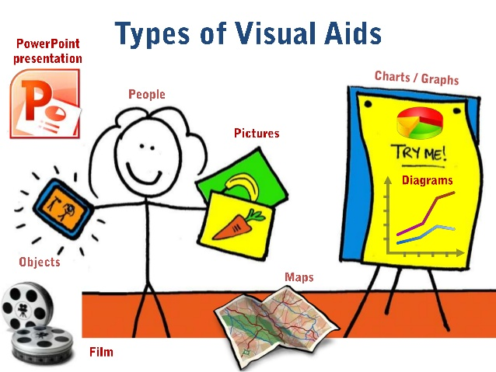
PRESENTATION SKILLS
CONCEPTS
Different Types Of Creative Visual Aid Ideas To Awe Your Audience
Notes:
Have you ever been tasked with making a speech or a presentation but don’t know how to make it truly remarkable? Well, visual aid is your answer.
Giving a presentation or speech is hard. You have to strike a balance between persuading or informing your audience while also maintaining their attention. The fear of your audience slipping away is very real. And a visual aid can help.
We sent out a survey to the Orai community to vote for their preferred visual aid. Here are the top ten creative visual aid ideas that you could use in your next presentation:

Slide 11

PRESENTATION SKILLS
CONCEPTS
Videos
Hans Rosling’s TED talk, titled ‘the best stats you have ever seen
Notes:
Videos emerged as the clear winner in all our surveys. We ran these surveys on all our social handles and reached out to successful speakers. 27.14% of all respondents prefer visual aids because they are easy to understand, can be paused during a presentation, and can trigger all sorts of emotions. That being said, it is also very tough to create good videos. However, there are more and more tools available to help you create amazing videos without professional help.
Hans Rosling’s TED talk, titled ‘the best stats you have ever seen,’ is one of the best speeches we have seen. He uses video pretty much for the speech’s entirety while not diverting the audience’s attention away from him. He does all this while also bringing out some optimism for the future of the world. We highly recommend this TED talk to learn how to use videos effectively as a visual aid and inject some positivity into your lives during these trying times.

Slide 12

PRESENTATION SKILLS
CONCEPTS
Demonstrations
Notes:
Demonstrations, also known as demos, are undoubtedly among the most effective visual aids available to you for communication. You can use demonstrations in two ways. One as a hook to captivate your audience. Prof. Walter Lewin was famous for using demonstrations as a hook during lectures. In his most famous lecture, he puts his life in danger by releasing a heavy pendulum to show that a pendulum’s period remains constant despite the mass.
Demonstrations also can be used to show how some things are done or how some things work. We use demonstrations to showcase how Orai works and how you can use them to improve your speaking skills.
18.57% voted for demonstrations because they are unique, interactive, up close, and have a personal touch.

Slide 13

PRESENTATION SKILLS
CONCEPTS
Roleplays
Use real time life stories
Notes:
Jokes aside, why do you think comedy shows are memorable? You guessed it right. Roleplays! Role–play is any speaking activity when you either put yourself into somebody else’s shoes or when you stay in your shoes but put yourself into an imaginary situation!
Nothing is more boring than a comedian delivering lines straight out of a joke book. Legendary comedians like George Carlin, Kevin Hart, Chris Rock, and Bill Burr use roleplays effectively and makes a mundane joke genuinely memorable.
Jokes aside, you can use roleplays in business presentations as well as speeches. Use real-life stories or examples in your role plays to make them authentic.
15.71% of the survey respondents voted for Roleplays because it is very close to real life and does not take the audience’s attention away from the speaker.

Slide 14
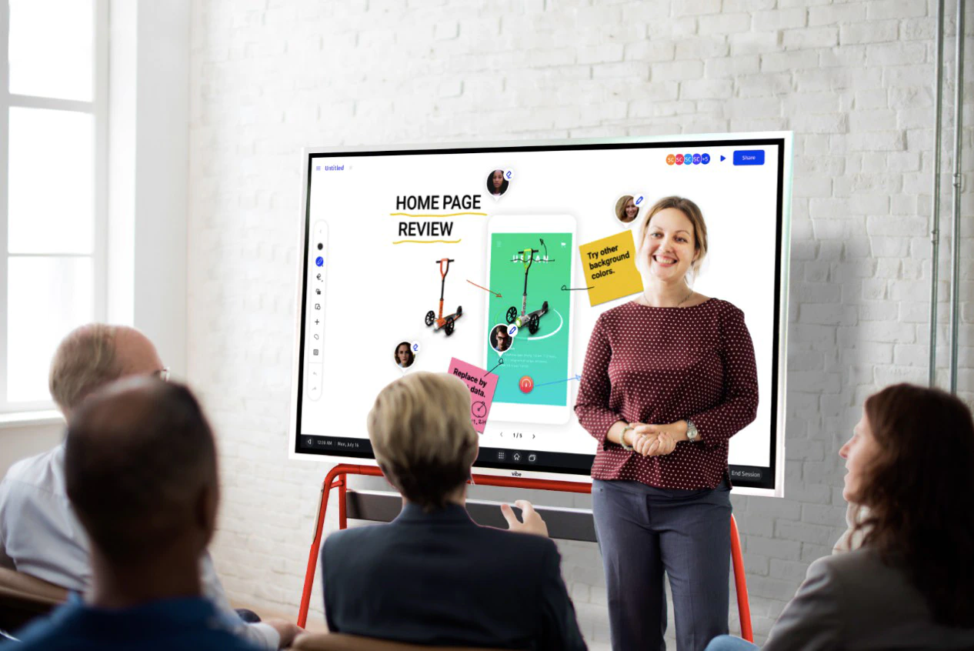
PRESENTATION SKILLS
CONCEPTS
Props
Notes:
With 12.86% of the votes, Props is number 4 on the list. A prop is any concrete object used in the delivery of a speech or presentation. Props add another dimension to our speech and help the listeners visualize abstract concepts like vision, milestones, targets, and expectations. It ties verbal to visual. That being said, introducing a prop into your speech or presentation should not seem forced. Use them sparingly to highlight the most critical points or stories in your address.
People voted for props because they feel that 3D visualization is much more useful than 2D visualizations. Props will make your presentations stand out because very few people use them today.

Slide 15

PRESENTATION SKILLS
CONCEPTS
Slides
Notes:
When we sent out the survey to the Orai community and some highly successful speakers, we were sure that slides/presentations come out on top. However, we were surprised by the results. With 12.86% votes, slides are number five on our list.
Presentations are effortless to create and, therefore, the most commonly used visual aid in business communications. Today, there are dozens of software programs available to help you make beautiful presentations. Microsoft PowerPoint is the pioneer in the space and continues to hold a significant market share.
Whatever is your preferred software, you need to keep your audience at the center while making presentations.
People described the ease of creation and the ability to incorporate other visual aids when asked why they chose presentations as their top visual aid.

Slide 16

PRESENTATION SKILLS
CONCEPTS
Audio
Notes:
The inclusion of Audio to this list can appear controversial. But it got a significant vote share in our survey and cannot be ignored. Audio can add a new dimension to your presentations where the audience is hearing your voice and other sound cues that can trigger various emotional responses. Especially when coupled with other visual aids, audio can be a powerful tool for making impactful presentations.

Slide 17

PRESENTATION SKILLS
CONCEPTS
Handouts

Slide 18
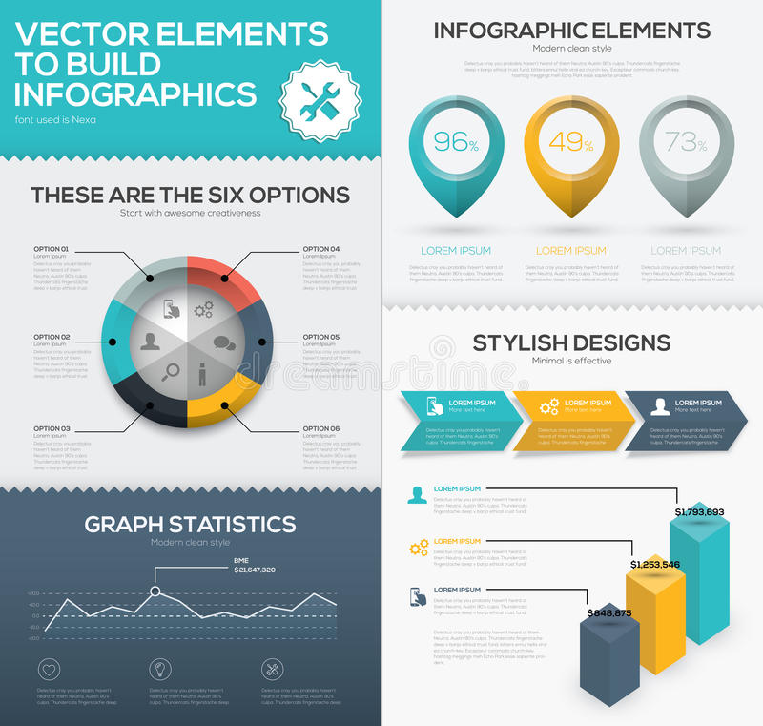
PRESENTATION SKILLS
CONCEPTS
What is a handout?
Notes:
A handout is a structured view of your presentation or speech that you can distribute amongst the audience.

Slide 19
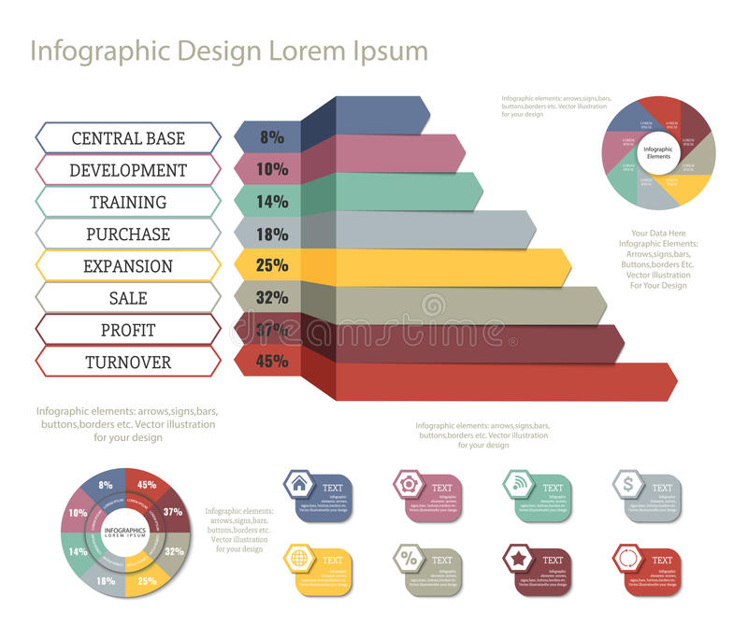
PRESENTATION SKILLS
CONCEPTS
What are the benefits of a handout?
Memorable
Notes:
Like how this blog gives more information than our YouTube video on the different visual aids, handouts can be used to furnish more information than your discourse itself. They give your audience something to take away after your presentation, making you and your presentation more memorable.
Are you going to be speaking about something overly technical? Then handouts are your friends. Handouts are also an opportunity to facilitate follow-ups if you specify your contact details.

Slide 20

PRESENTATION SKILLS
CONCEPTS
Physical & Online Whiteboards

Slide 21

PRESENTATION SKILLS
CONCEPTS
What is a whiteboard?
Notes:
Traditionally, whiteboards are white, shiny, and smooth boards on which texts and diagrams are made using non-permanent markers. It is widely used in professional presentations, brainstorming sessions, and group discussions. Post-COVID, more and more companies are moving to online whiteboards. Online whiteboards are software that provides a space where individuals across the globe can collaborate online. Many companies have already moved beyond the whiteboard and started using online whiteboards for their meetings and discussions.

Slide 22

PRESENTATION SKILLS
CONCEPTS
What are the benefits of a whiteboard?
Online whiteboards will transform virtual meetings into a collaborative experience
Notes:
A whiteboard helps listeners better visualize thoughts, concepts, and ideas. It is also a better alternative to the blackboard for a smaller audience as it is tidier and easier to use. Online whiteboards can be used instead of traditional whiteboards without being limited by space constraints. Online whiteboards will transform virtual meetings into a collaborative experience.

Slide 23

PRESENTATION SKILLS
CONCEPTS
Blackboard

Slide 24

PRESENTATION SKILLS
CONCEPTS
What is a blackboard?
Notes:
Blackboard (aka chalkboard) is a surface on which texts or diagrams are made using chalk, made out of calcium sulfate or calcium carbonate. Blackboards are typically used in classrooms for large groups of students.

Slide 25

PRESENTATION SKILLS
CONCEPTS
What are the benefits of blackboards?
Notes:
Blackboard is one of the foremost and most popular teaching aid. Blackboard is useful for teaching as it helps instructors move from easy to complex topics in an organized manner. Diagrams, symbols, charts, and drawings can be introduced between a discourse to bring life to rather dull topics. Blackboards are highly interactive, where both the teacher and students can participate during a speech.

Slide 26

PRESENTATION SKILLS
CONCEPTS
Flipchart

Slide 27

PRESENTATION SKILLS
CONCEPTS
What is a flipchart?
Notes:
Flipcharts consist of a pad of large sheets of paper bound together. It is typically fixed to the upper edge of a whiteboard or canvas. Flipcharts are easy to create and inexpensive fit for small groups of people.

Slide 28

PRESENTATION SKILLS
CONCEPTS
What are the benefits of presenting using a flipchart?
No electricity needed
Notes:
Nowadays, everybody seems to be only interested in making presentations that are powered by computer-generated slide decks. However, the flip chart has its charm. Since most presentations consist of less than ten people, flip charts can be a refreshing change to the standard slide deck. Moreover, flipchart does not require electricity. No electricity and no software means less of those last-minute hick-ups.

Slide 29

PRESENTATION SKILLS
CONCEPTS
How to make an informative speech with visual aids in presentations
Notes:
If you have a presentation coming up soon, you can follow the instructions below to learn how you can take advantage of visual aids:

Slide 30

PRESENTATION SKILLS
CONCEPTS
Determine your overall objective
Notes:
The aim of your presentations depends on you, what information is being presented, and your audience. The motivational speaker and the classroom teacher may approach the same types of visual aids differently due to differences in overall objectives. For instance, if you aim to inspire and remind your audience of salient points, a poster template should serve well, infographics work well when you are trying to show relationships between complex information. A chart will be quite effective if you seek to explain a given set of data.

Slide 31
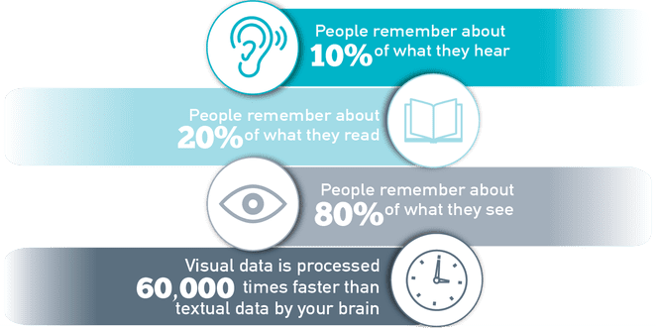
PRESENTATION SKILLS
CONCEPTS
Choose appropriate visual aids in presentations
Notes should ne bold and brief. one line of text
Notes:
After identifying the overall aim of your presentation, you have to match it with the right visual aids example. Will a graph, picture, or video suffice?
If you are using the PowerPoint Presenter, ensure you focus mainly on the media that best conveys your message. Make sure that the notes you add a bold and brief. Try to keep your sentence in one line of text.

Slide 32
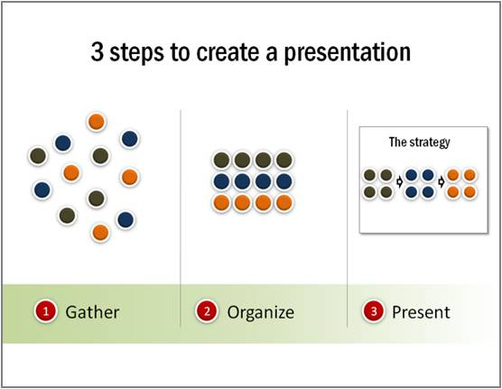
PRESENTATION SKILLS
CONCEPTS
Prepare thoroughly
Take notes
Notes:
You will spend some time preparing your visual aids before the day of your presentation. It is good to allow yourself enough time to prepare so you can perfect your work accordingly. Take note of when, where, and how you are going to use your visual aids. If you discover some inconsistencies, you can compensate for them by adjusting your choice or use of visual aids in presentations.
After you have a final draft of your visual aids, run a series of sessions with them. Let your friends or colleagues be your audience and ask for their honest feedback. Make appropriate adjustments where necessary.

Slide 33

PRESENTATION SKILLS
CONCEPTS
During presentation
Notes:
First, you need to be comfortable and confident. A neat and appropriate dressing should boost your confidence. Follow the tips below during presentations.
Keep your face on your audience. It may help to look a little above their heads while presenting.
Only point to or take the visual aid when needed. When you do, explain what you mean immediately.
Do not read texts on your visual aids verbatim.
Once a visual aid has served its purpose, you should keep it away from your audience’s view.
If you need more help with boosting your confidence, we have written a detailed piece on how to conquer your fear of speaking in front of people.

Slide 34
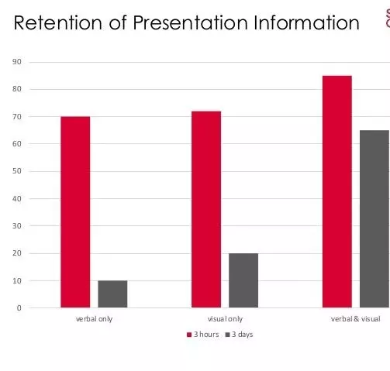
PRESENTATION SKILLS
CONCEPTS
What is the importance of using visuals in giving a presentation?
Notes:
Visual aids in presentations are invaluable to both you and the audience you hope to enlighten. They make the job way easier for you, and the audience leaves feeling like they learned something. Apart from their time-saving abilities, here are some reasons why you need to incorporate visual aids in your presentations:
Visual aids can help your audience retain the information long-term.
The human brain processes images faster than text, so visuals make us understand things faster
Using visual aids makes your presentations more enjoyable, interactive, and memorable
Visual aids help your audience connect and relate with you better
Presentations with visual aids are less likely to be misunderstood or misrepresented. They are usually easier to understand and leave little room for confusion
Visual aids are great for people with learning disabilities
Visual aids act as key cards and pointers for the presenter and help you keep track of what you’re saying

Slide 35

PRESENTATION SKILLS
CONCEPTS
What are the ideas for speech topics using visual aids?
Notes:
Use a picture or image that closely represents the topic. A one-hundred-dollar note can suggest topics revolving around money and finances
Use a chart showing trends or statistics that your audience finds appealing. You can use popular sayings or quotes to generate topics your audience can relate to.
Newspaper headlines on related issues can be good starters for opinion-based topics.

Slide 36







/ethnuscodemithra
Ethnus Codemithra
/ethnus
/code_mithra
THANK YOU
https://learn.codemithra.com/
codemithra@ethnus.com
+91 7815 095 095
+91 9019 921 340

